Slide 1

Java Evolution
Java Introduction
Java Features
How Java Differs from other OO languages

Slide 2
Java - An Introduction
Java - The new programming language developed by Sun Microsystems (James Gosling) in 1991.
Originally called Oak.
Java Authors: James Gosling, Arthur Van Hoff, Andy Bechtolsheim
A general-purpose object-oriented language.
Designed for easy Web/Internet applications

Slide 3
Java - An Introduction
Originally created for consumer electronics (TV, VCR, Freeze, Washing Machine, Mobile Phone).
Java - CPU Independent language
Internet and Web was just emerging, so Sun turned it into a language of Internet Programming.
It allows you to publish a webpage with Java code in it.

Slide 4
Java Milestones
Year | Development
1990 | Sun decided to developed special software that could be used for electronic devices. A project called Green Project created and head by James Gosling.
1991 | Explored possibility of using C++, with some updates announced a new language named “Oak”
1992 | The team demonstrated the application of their new language to control a list of home appliances using a hand held device.
1993 | The World Wide Web appeared on the Internet and transformed the text-based interface to a graphical rich environment. The team developed Web applets (time programs) that could run on all types of computers connected to the Internet.

Slide 5
Java Milestones
Year | Development
1994 | The team developed a new Web browsed called “Hot Java” to locate and run Applets. HotJava gained instance success.
1995 | Oak was renamed to Java, as it did not survive “legal” registration. Many companies such as Netscape and Microsoft announced their support for Java
1996 | Java established itself it self as both “the language for Internet programming” a general purpose OO language.
1997 | A class libraries, Community effort and standardization, Enterprise Java, Clustering, etc..

Slide 6
Java Features
Familiar, Simple, Small
Compiled and Interpreted
Platform-Independent and Portable
Object-Oriented
Robust and Secure
Distributed
Multithreaded
High Performance
Dynamic and Extensible

Slide 7
Cont…
Familiar,Simple & small
Java does not use Preprocessor header files, goto statement and many others
no pointers
automatic garbage collection
rich pre-defined class library http://java.sun.com/j2se/1.4.2/docs/api/

Slide 8
Cont…
Object-Oriented
focus on the data (objects) and methods manipulating the data
Almost every thing in Java is Object.
all functions are associated with objects
almost all datatypes are objects (files, strings, etc.)
potentially better code organization and reuse

Slide 9
Cont…
Platform-Independent and Portable
Java is portable.
1) Java Complier generates bytecode that can be
implemented on any machine.
2) the sizes of the primitive data types are always the same
application runs on all platforms

Slide 10
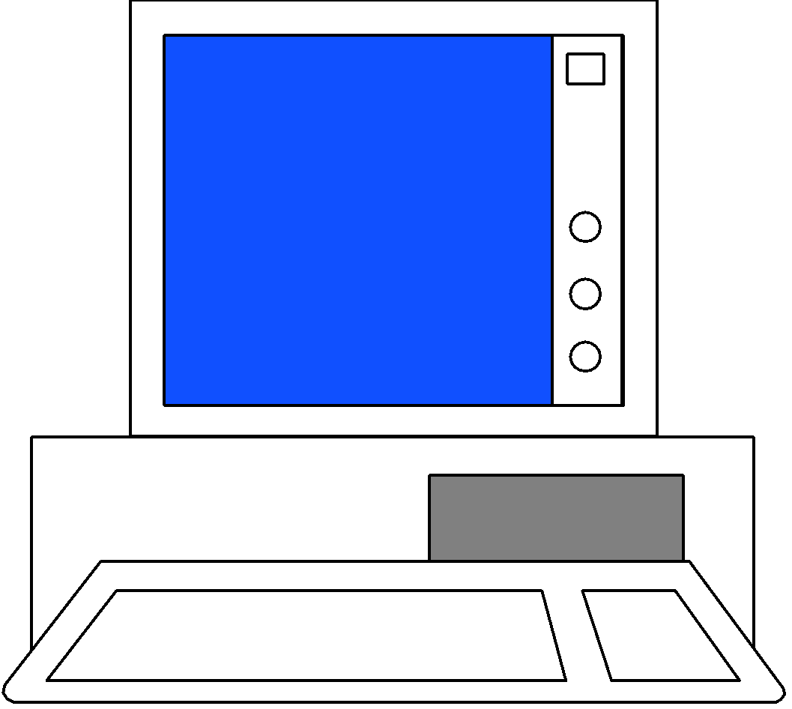
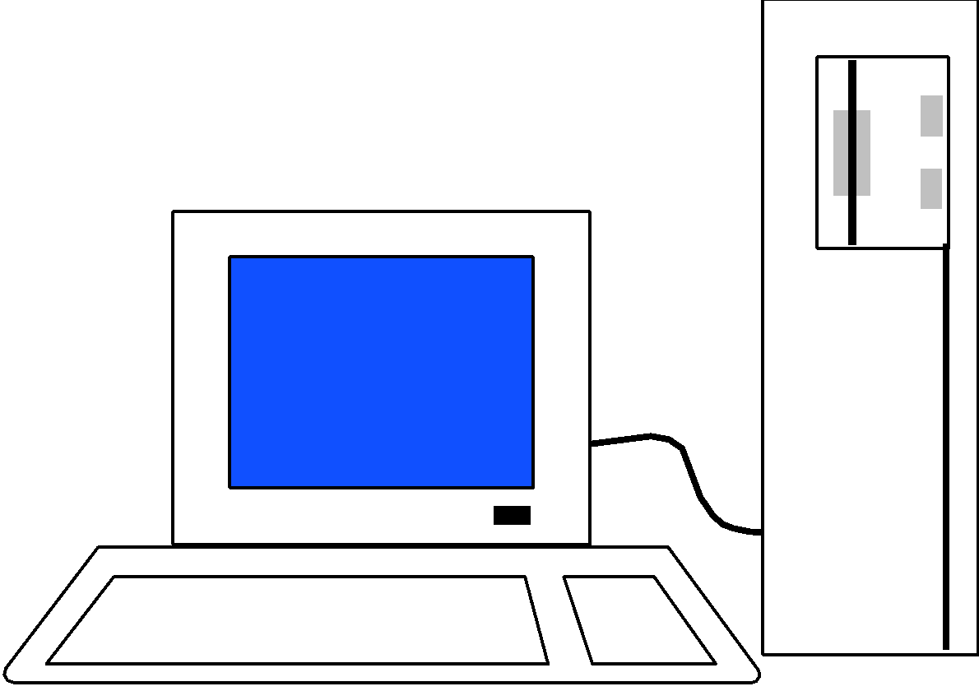
Cont…
JAVA COMPILER
(translator)
JAVA BYTE CODE
(same for all platforms)
JAVA INTERPRETER
(one for each different system)
Windows 95
Macintosh
Solaris
Windows NT

Slide 11
Cont…
Compiled and Interpreted
java compiler generate byte-codes, not native machine code
the compiled byte-codes are platform-independent
java bytecodes are translated on the fly to machine readable instructions in runtime (Java Virtual Machine)

Slide 12
Cont…
Programmer
Hardware and
Operating System
Source Code
Byte Code
Text Editor
Compiler
Interpreter
.java file
.class file
Notepad, vi
javac
java
appletviewer
netscape

Slide 13
Cont…
Robust and Secure
usage in networked environments requires more security
Provides many safeguard to ensure reliable code.
Strict compile time & run time type checking.
memory allocation model is a major defense
access restrictions are forced (private, public)

Slide 14
Cont…
Distributed
Designed as distributed lang. For creating application on network.
Java program can access remote access remote objects on internet

Slide 15
Cont…
Multithreaded
Handles multiple task simulteniously
Java tools support multiprocess synchronization.

Slide 16
How Does Java Compares to C++ and Other OO Languages
C++
C
Java

Slide 17
Java better than C ?
No Preprocessor
No Global Variables
No data types struct, union and enum
No Goto ,size of and typedef
No type modifier keywords uto,extern,register,signed and unsigned.
No Pointers
Add new operator instanceof and >>>
Add labelled break and continue

